Slide 1
PL-600 Robotic Process Automation

Slide 2
Agenda
Review the need for Robotic Process Automation
Explore Power Automate Desktop
Considerations for creating and running desktop flows
Introduction to Process advisor
Notes:
Robotic Process Automation is concerned with the automation of legacy applications. Understanding the capabilities of Power Automate Desktop is required when integrating a Microsoft Power Platform solution. This module is concerned with Power Automate Desktop and its capabilities.
In this module, you will:
- Explore options for automation and how to choose where to start.
- Explore scenarios for Power Automate Desktop.
- Understand the components for running Power Automate desktop flows.

Slide 3

Introduction to Robotic Process Automation
Notes:
Introduction to Power Automate Desktop and the use cases for desktop flows
This unit introduces Robotic Process Automation (RPA) and the use cases for Power Automate desktop flows.

Slide 4

What are the legacy automation issues faced when creating solutions
Classroom discussion
Notes:
Ask for examples where the students have hit roadblocks with integrating with existing systems
Ask for examples where the students have had issues connecting to on-premises systems
Discuss how RPA works by capturing and replaying clicks and keyboard actions
Prompt discussion on how much can be automated – it is a lot if you look!

Slide 5
Characteristics of RPA
Capture steps performed by a user
Repeat the steps
Desktop application user interface
Perform on the application user interface
Web applications in browsers
Simple to complex tasks and processes
Operating system actions
Reduce costs
Clicks and keyboard entry
Reduces errors
Notes:
There are many legacy applications that do not have a method for accessing their data or functionality except through their user interface. RPA solutions operate by generating a list of actions by capturing the steps a user performs in an application's user interface. The RPA solution then performs the automation by repeating the steps in the application's UI, effectively simulating the user's actions in software. RPA enables the automation of applications that do not have an API that can be used for such automation tasks.
Robotic Process Automation (RPA) is garnering a lot of interest and attention. By automating simple tasks, RPA solutions promise to lower costs while reducing errors.

Slide 6
Opportunities for automation
The best organizations are powered by strategic and creative people, but they are often forced to spend nearly half their time on repetitive tasks that could be automated with current technology
Who
60% of all occupations have at least 30% automatable activities
Scope
Almost 50% of work activities globally can be automated using current technology
Improvement
Data collection and processing times can improve by 64% with automation
Notes:
When analyzing work performed by users the following has been observed:
- 60% of all occupations have at least 30% automatable activities.
- Almost 50% of work activities globally can be automated using current technology.
- Data collection and processing times can improve by 64% with automation.
The best organizations are powered by strategic and creative people, but they are often forced to spend nearly half their time on repetitive tasks that could be automated with current technology.

Slide 7
Automating legacy systems
Issues that prevent automation
Lack of a modern API
Systems are complex and costly to replace
Connecting to on-premises systems
Notes:
A major roadblock in automating systems and workflows can be that legacy and other third-party applications have no modern API data access that allow tools such as Power Automate to include them in their cloud flows.
It is not always possible to replace the legacy applications either because of difficulty or the costs to replace them. In addition, many legacy applications are on-premises and it can be hard to link to the on-premise applications and combine them with cloud services in an end-to-end automation process.
A number of RPA solutions have been developed to solve this problem. Power Automate desktop flows are Microsoft's answer to this problem.

Slide 8
Microsoft's approach to automation
Accelerate productivity
Minimize repetitive, manual, time-consuming tasks and create more time for your teams to focus on strategic work.
Automate at scale
Allow everybody in your organization to automate workflows using connectors for their favorite on-premises and cloud-based apps and services. From end users, professional developers, to IT.
Apply intelligent automation
Streamline how you work by combining the power of AI with automated workflows and business process.
Integrate automation, more securely
Enable end users to build automated workflows that comply with established policies and focus your skilled IT resources on more complex, strategic work.
Notes:
There are many SaaS services that can be accessed with modern REST APIs that automation tools such as Power Automate can connect to and orchestrate for the purposes of integration and automation of tasks.
Microsoft's approach to automation is:
- Accelerate productivity: Minimize repetitive, manual, time-consuming tasks and create more time for your teams to focus on strategic work.
- Automate at scale: Allow everybody in your organization to automate workflows using connectors for their favorite on-premises and cloud-based apps and services. From end users, professional developers, to IT.
- Apply intelligent automation: Streamline how you work by combining the power of AI with automated workflows and business process.
- Integrate automation, more securely: Enable end users to build automated workflows that comply with established policies and focus your skilled IT resources on more complex, strategic work.

Slide 9
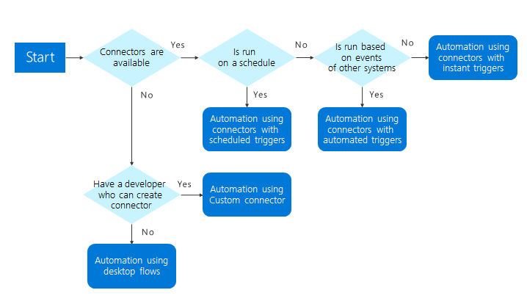
Power Automate
Options
Pre-built Connectors
Custom connectors
Desktop flows
Notes:
Using Power Automate, a solution architect can create innovative solutions. However, what happens when there isn't a connector available. If the service has a modern REST API then you can create a custom connector. If there isn't an API then Power Automate desktop flows are available.
This flowchart can help you determine how to architect your automation.

Slide 10
Use cases for RPA
Power Automate desktop flows can automate repetitive tasks
Invoice processing
Recruitment
New user onboarding
Notes:
Power Automate desktop flows automate repetitive tasks and there are many scenarios that Power Automate desktop flows can be employed in. Some use cases for desktop flows are as follows:
- Invoice processing: Processing invoices includes many repetitive tasks, which, if performed incorrectly, can lead to delayed or incorrect payments. For instance, invoices need to be checked against the corresponding purchase orders. Desktop flows can process invoices and automatically perform the required validation checks.
- Recruitment: Desktop flows could gather and collate applications from multiple job portals into a single applicant list.
- New user onboarding: New joiners to an organization must be set up on many systems. While you can use tools such as PowerShell to perform some setup, there are some applications for which there is no automation available. Desktop flows can be used to add users and configure their settings automatically through the applications' user interfaces.

Slide 11

What are the solution architect’s role?
Classroom discussion
Notes:
Ask What should the solution architect consider for using RPA to solve - be creative!

Slide 12
Role of the solution architect
The solution architect should look for good opportunities for automation.
Standard process
High frequency
Predictable processes
Prone to human error
High risk of failures and impact
Notes:
By using Power Automate cloud and desktop flows, a solution architect can design end-to-end processes that encompass modern cloud services, legacy desktop, and web applications.
The solution architect should look for opportunities for automation. Good opportunities exhibit the following characteristics:
- Standard process: Is the process well understood and consistent in how it needs to be executed?
- High frequency: Is this a process that runs frequently and the ROI exists to spend build cycles on it?
- Predictable processes: Are the outcomes predictable or do they require any judgement calls by humans?
- Prone to human error: Is there a risk that a human may introduce errors as a result of manually completing this process? Are there a lot of steps that are easy to perform out of order?
- High risk of failures and impact: Is the risk and/or impact of a failure high that could be mitigated through automation?
There are many uses for desktop flows. You can consider any scenario where there is the processing of forms, extracting data from systems, or processing claims where the data needs to be verified for automation with desktop flows. If you have rule-based processing, desktop flows are a viable candidate for automating those processes.
The introduction of Power Automate Desktop opens up many scenarios that would not have been possible or would have been extremely difficult and expensive to achieve.
Desktop flows can be also be used for situation where there is an API but the API does not expose all of the operations available in the application's UI. In such circumstances, Power Automate Desktop maybe the answer.
During design, the solution architect should separate flows into smaller automations so that you don't have a single automation that covers the entire process. There are several reasons why you should make multiple, smaller flows:
- Multiple people can work on the automation.
- Small flows with common steps may be able to be reused.
- Error handling does not need to be as sophisticated.
- Maintenance is easier.
- Easier to manage the automation if a step fails.

Slide 13

Explore Power Automate Desktop
Notes:
Overview of Power Automate Desktop software and capabilities

Slide 14
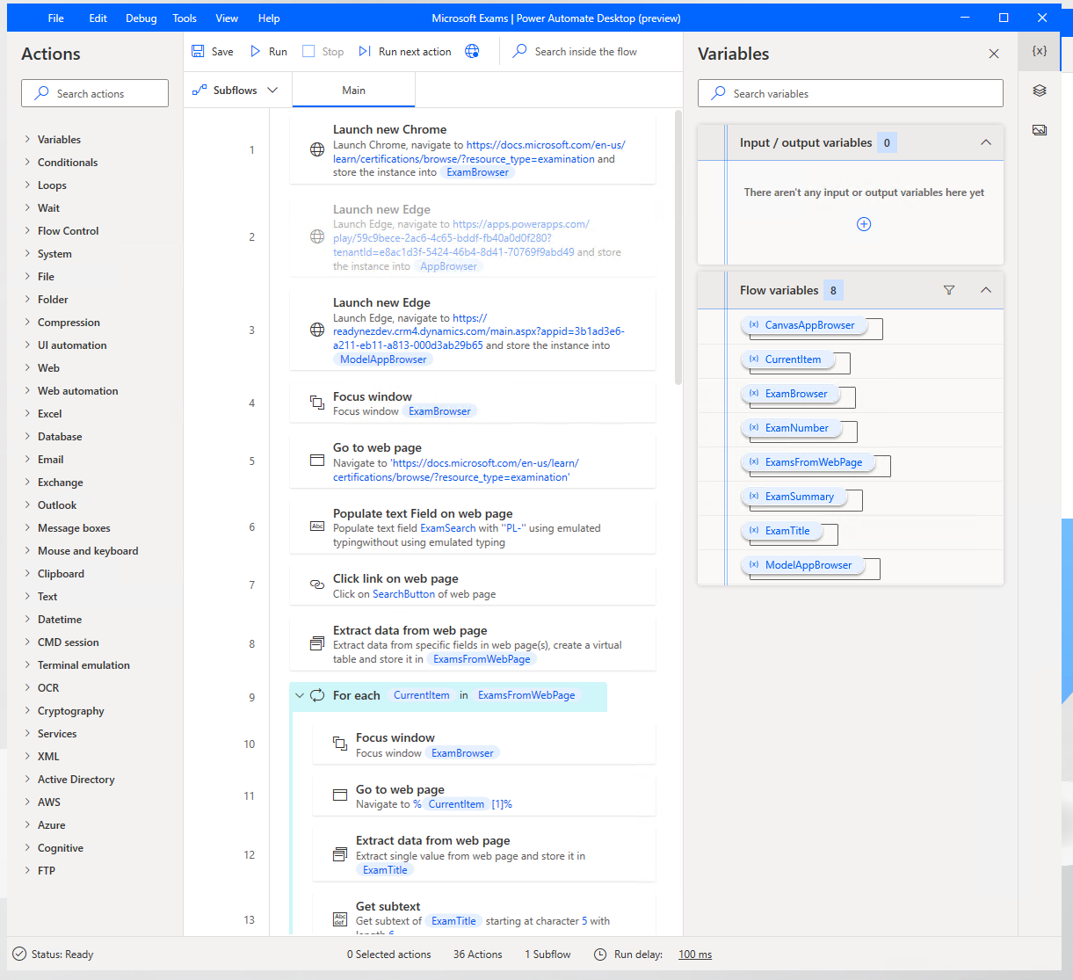
Power Automate Desktop
Tools for building and running desktop flows
Build
Capture and edit user actions for desktop and mobile applications
Running
Runs desktop flows
Notes:
Power Automate desktop flows are for automation where there is no connector or API available to use. There are many legacy applications that do not have a method for accessing their data or functionality except through their user interface.
Power Automate Desktop flows use Robotic Process Automation (RPA) techniques to automate user actions on these legacy applications. These techniques require software to be installed on the computers where the applications are installed. The software required to create, edit, and run desktop flows is called Power Automate Desktop.
Whether working with modern or legacy apps, on-premises or in the cloud, Power Automate Desktop can automate rule-based UI tasks by recording mouse clicks, keyboard inputs, and data entry. As well as entering data, Power Automate Desktop can also extract information from the application user interface. Once the actions have been recorded, Power Automate Desktop has a rich editor for adjusting these user actions to create complex desktop flows.
Power Automate desktop flows can be run attended with the user manually initiating the flow, or unattended with desktop flows running on Virtual Machines in Azure.
Power Automate desktop flows are a valid way to perform integrations and automation when there is no other alternative, or when developing an integration would be expensive and time consuming.
Power Automate cloud flows are explained in the Power Automate Architecture module.

Slide 15
Software
Power Automate Desktop
To editing and running desktop flows
Browser Extensions
For web applications
On-premises data gateway
For connecting cloud to desktop
Windows application
Extensions for modern web browsers
Used for Power BI, Power Apps, Power Automate, Logic Apps
Windows 10, Server 2016, Server 2019
Google Chrome, Microsoft Edge, Mozilla Firefox supported
Installed on same computer as PAD
Windows 10 Pro/Enterprise required for unattended mode
Additional browser settings
Required for unattended mode
Notes:
Desktop software
Unlike the rest of the Microsoft Power Platform tools, Desktop flows require software to be installed on your local computer. You need this software because you need to interact with software applications that are not accessible from the cloud.
The Power Automate Desktop app is a Windows application that you use to create, edit, and run desktop flows.
You will need a computer running Windows 10, Windows Server 2016, or Windows Server 2019 to install Power Automate Desktop.
For unattended flows Windows 10 Home is insufficient and Windows 10 Pro or Windows 10 Enterprise is required.
To initiate a desktop flow from the cloud, a second application is required to be installed on the computer where Power Automate Desktop is installed. This is the On-premises data gateway. This tool allows desktop flows to be triggered by a Power Automate cloud flow.
As a solution architect, you will need to liaise with the IT department to arrange for these software applications to be installed. Local software installation can often take much longer to plan and implement than you may think due to IT policies and procedures. If you are planning to use RPA in your solution, you should look to address the deployment of this software as early as possible.
Browser software
To interact with web applications, a modern web browser is required. The latest version of the Google Chrome browser, Microsoft Edge, and Mozilla Firefox are supported.
A browser extension is required to be installed. These can be installed by the Power Automate Desktop installer but may require additional configuration. Again, the solution architect will need to liaise with the IT department as installing browser extensions maybe blocked by corporate IT policies.
There are some further settings for browsers that should be configured. These are described in <https://docs.microsoft.com/power-automate/desktop-flows/using-browsers> and the solution architect will need to arrange for these settings to be applied.

Slide 16
Requirements
Microsoft Power Platform environment with a Dataverse database
Default environment might need a Dataverse database adding
Unattended flows require additional licensing
Notes:
Power Automate Desktop requires access to a Microsoft Power Platform environment that has a Dataverse database. You may need to create a database for the default environment if one does not already exist.

Slide 17
Considerations when deploying Power Automate Desktop
Solutions
Deployment
Power Automate desktop flows are solution aware
Post deployment manual actions required
Use Environment variables
Include actions in deployment plan
Plan for software deployment and browser configuration with the IT department
Notes:
Solutions
Desktop flows are solution aware and can be included in solutions and application lifecycle management processes.
You should make use of Environment variables for any property used in a Desktop flow that might vary between environments.
Deployment
Post deployment of a desktop flow via a solution there are manual tasks that may need to be performed:
- Gateways: Configure desktop flows to connect using the gateway(s) for the environment
- Environment variables: Set the values for the environment.
- End-user authentication: Configure end-user authentication so the desktop flow can take actions on the user’s behalf.
The solution architect should ensure that these steps are included in the deployment plan for the solution.

Slide 18
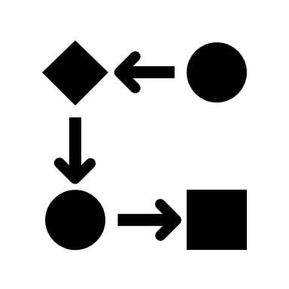
Creating desktop flows
Notes:
Key concepts for capturing and editing the steps in desktop flows

Slide 19

Capture steps
Two options
Desktop recorder
Records the steps on Windows native applications
Web recorder
Records steps in a browser for web applications in browsers
Notes:
Power Automate Desktop can both capture the steps performed by the user and edit the steps in desktop flows.
The user can record tasks with
- Desktop recorder: Records the steps on Windows native applications.
- Web recorder: Records steps in a browser for web applications.
The Desktop recorder identifies and highlights objects in the application user interface such as buttons, menus, and fields. It then records the mouse clicks and keyboard entries against that object.
The web records identifies what is clicked and entered into a web page. The process is similar and is tailored towards web applications.

Slide 20
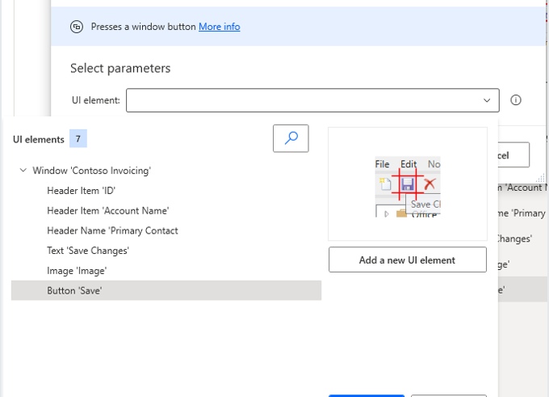
Editing steps
Extract information
Remove actions
Add new actions
Edit the selected objects
Add conditionals and loops
Notes:
Once steps have been recorded, you can edit to remove unnecessary actions and add further actions. You can also edit the objects selected in the application and add new UI objects.

Slide 21
Actions
Power Automate has a very wide range of capabilities and can perform many actions including:
Running SQL queries against a SQL Server database.
Manipulating the contents of an Excel worksheet.
Processing emails in Outlook
Running PowerShell scripts on the local computer
Copying to and from the clipboard
Accessing cloud services
Notes:
Power Automate has a very wide range of capabilities and can perform many actions including:
- Running SQL queries against a SQL Server database.
- Manipulate the contents of an Excel worksheet.
- Process emails in Outlook.
- Run PowerShell scripts on the local computer
- Copy to and from the clipboard
- Access Active Directory objects
- Access cloud services
Power Automate Desktop is very powerful with many possible actions. The solution architect should decide the most appropriate technology for performing actions. For example, should a SQL query be performed using a desktop flow, a cloud flow, or by an Azure function.

Slide 22
Variables
Define values that change for each run of a desktop flow
Flow variables
Input and Output variables
Notes:
Flow variables allow information to change in every run of a desktop flow. If you are using a desktop flow for any type of data entry, you will need flow variables to define the fields that you need to enter. The solution architect should encourage the use of flow variables and ensure that there is a naming convention for variables.
Input variables are information that you pass to a desktop flow. Output variables are outcomes that the desktop flow passed back after the desktop flow has run. Power Automate Desktop provides the ability to receive input values from cloud flows and return values back to the cloud flow by using output variables. As a result, your automations can be seamlessly integrated. The solution architect should ensure that the input and output variables are specified at the design stage as it is likely that cloud and desktop flows will be built by different makers.
If input variables are different for each environment, then you should define Environment Variables for input variables in the flows.

Slide 23

Running desktop flows
Notes:
This unit is about Running Desktop flows in attended and unattended modes

Slide 24
Attended vs Unattended
Attended
The quick brown fox jumps over the lazy dog
Unattended
The quick brown fox jumps over the lazy dog
Automating individual tasks across desktop and web applications
High volume automation where no interaction is required
Initiated on demand
Initiated from Power Automate cloud flows
The user must be logged in
If a user is logged in, an unattended desktop flow cannot run
Notes:
Desktop flows can be run in one of two modes:
- Attended
- Unattended
Attended
Attended flows are aimed at automating individual tasks across desktop and web applications. The user can interact with the desktop flow if required, for example if a decision is required.
Attended flows are initiated on demand. A user can start an attended desktop flow from their local computer.
The user must be logged in to run an attended desktop flow.
Unattended
Unattended desktop flows are used for high volume automation where no interaction is required. Unattended desktop flows are initiated from Power Automate cloud flows. The cloud flow sets the input variables and receives the output variables.
If a user is logged in, an unattended desktop flow cannot run.

Slide 25
Virtual machines
Use for unattended desktop flows
Use auto-scaling rules to reduce costs
Solution architect determines number of machines and costs
Notes:
One option for running unattended desktop flows is to use the user's computers when they are not working e.g., overnight or at weekends. This does require that the user actually logs off and that the software is configured the same on each of the teams' computers. This is not always the case.
A more robust option is to create Virtual Machines in Azure. This has several advantages:
- The software configuration can be consistent across the machines.
- The number of Virtual machines can be scaled as necessary.
- The desktop flows can run during working hours.
If using virtual machines, the solution architect will need to define the specification for the virtual machines and determine the costs of running the virtual machines. The solution architect should ensure that auto-scaling rules are defined to reduce costs when the virtual machines are not required and to maximize hardware productivity.

Slide 26
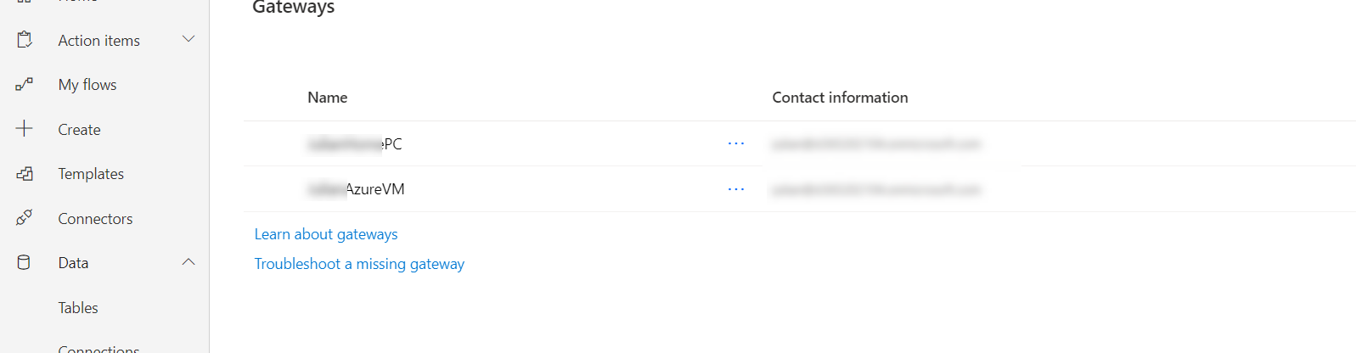
Gateways
On-premises data gateways must be installed on each computer to allow the computer to take part in an unattended desktop flow
Notes:
An on-premises data gateway must be installed on each computer to allow the computer to take part in an unattended desktop flow. On premise data gateways once installed, are managed from the cloud.

Slide 27
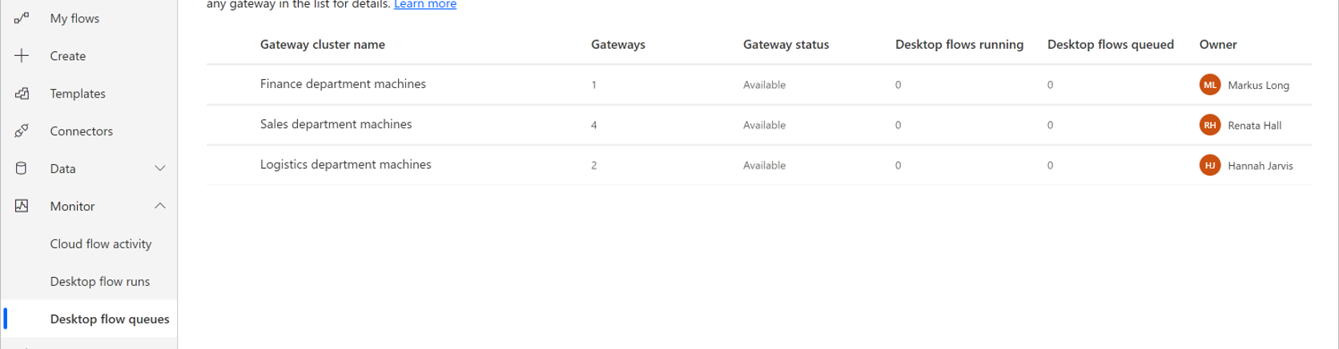
Clusters
Gateways can be grouped into clusters that wil run instances of a desktop flow.
Notes:
Gateways can be grouped into clusters that will run instances of a desktop flow.
The solution architect should define the clusters that are required and the priorities for desktop flow jobs.

Slide 28
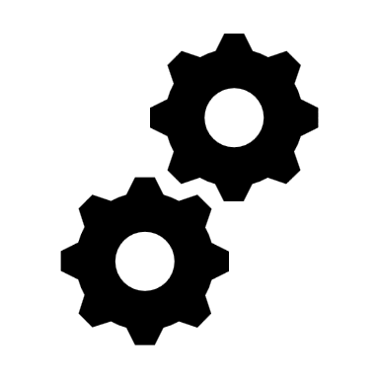
Introducing Process advisor
Notes:
Process advisor is a tool that records and analyzes your business tasks. Process advisor is a process mining tool that identified bottlenecks in business processes. You use this tool to identify opportunities for automation and optimization.
Process advisor allows you to:
- See improvement opportunities.
- Track important metrics.
- Create work efficiencies.
Process advisor is a tool the solution architect should consider using when gathering requirements and when mapping business processes.

Slide 29
Process advisor
Record processes
Process advisor uses Power Automate Desktop to record business tasks.
Users record the tasks they perform.
Group activities
You can view the actions captured by users and then group actions into activities.
Analyze processes
Process advisor analyzes each of the activities and identifies the frequency of paths through the process and the variants.
Analyze discovers inefficiencies and shows optimization and automation opportunities.
Visualize processes
Process advisor automatically generates a process map that visualizes the activities process.
Notes:
Record processes
Process advisor uses Power Automate Desktop to record business tasks. Users record the tasks they perform.
You can view the actions and must group actions into activities.
Analyze processes
Process advisor then analyzes each of the activities and identifies the frequency of paths through the process and the variants.
Analyze discovers inefficiencies and shows optimization and automation opportunities. Process advisor automatically generates a process map that visualizes the activities process.

Slide 30
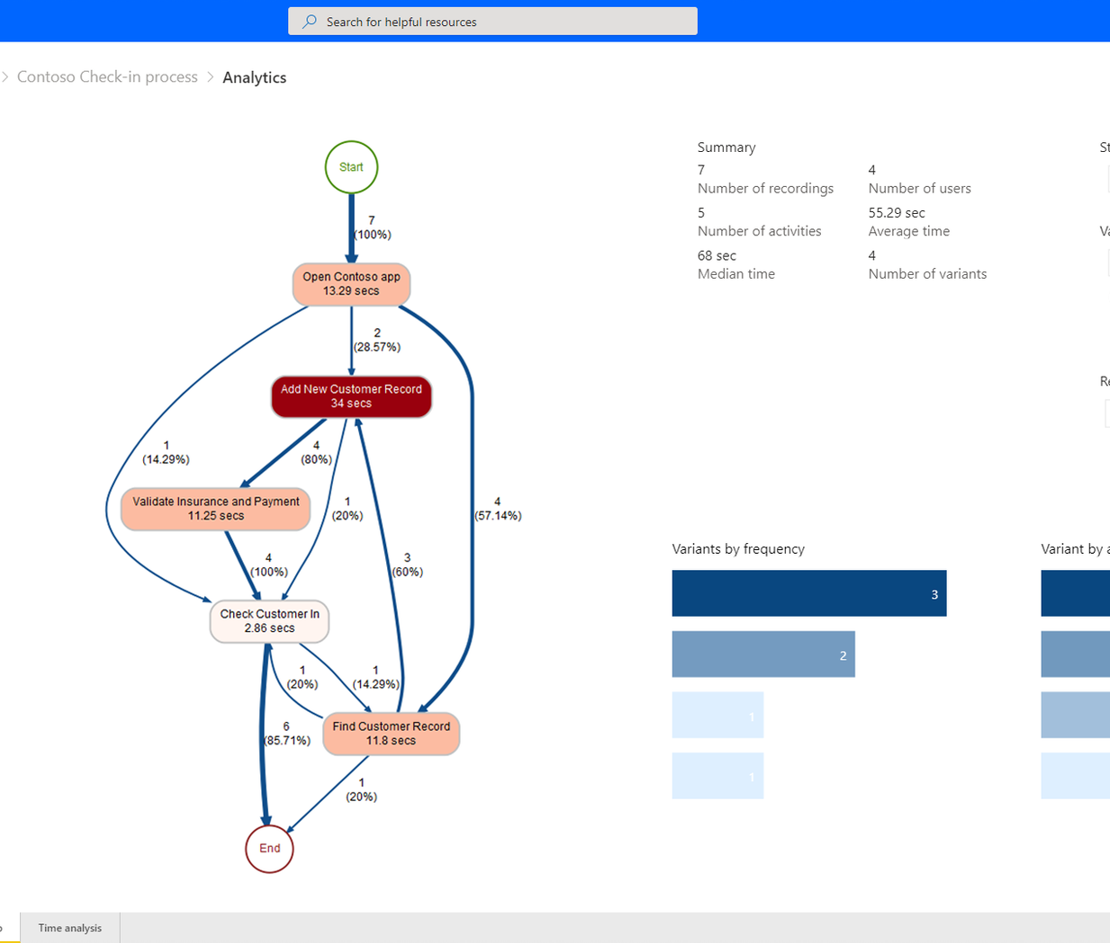
Process advisor
Process map
Visualize
In the process map you can see which activities take the longest, how many variations of the there are, and what variations and actions take the most time
Identify
Using this information, you can identify which automations are required and the type of automation to create.
Notes:
In the process map you can see which activities take the longest, how many variations of the there are, and what variations and actions take the most time.
Using this information, you can identify which automations are required and the type of automation to create.

Slide 31
Summary
Power Automate desktop flows enable integrations and automations that were no possible before
The solution architect should consider using Power Automate Desktop as part of the solution
The solution architect can design end-to-end automation across web, legacy, and on-premises systems
Notes:
The solution architect should understand how to use RPA to create end-to-end automation across web, legacy, and on-premise systems. Power Automate Desktop enable more options for automating and integrating solutions and its use should be carefully evaluated by the solution architect.

Slide 32
Closing slide

Slide 33
References
Automate processes with Robotic Process Automation and Power Automate Desktop Learning Path https://docs.microsoft.com/learn/paths/work-automation-flow/
Work with different technologies in Power Automate Desktop Learning Path https://docs.microsoft.com/learn/paths/pad-work-different-technologies/
Build expertise with Power Automate Desktop Learning Path https://docs.microsoft.com/learn/paths/pad-build-expertise/
Power Automate guidance documentation https://docs.microsoft.com/power-automate/guidance/
Notes:
It is good practice to tie back your ILT deliveries to role-based learning materials on Microsoft Learn. What is listed here should supplement your delivery and the role-based training your course is affiliated with. It is important to give the learners continued education opportunities for growth.

